Slide 1

Machine Learning Foundations
Intro to Linear Algebra
An Interactive Primer on
the Theory and Practice of
Tensor Manipulation in Python
Jon Krohn, Ph.D.
jonkrohn.com/talks
github.com/jonkrohn/ML-foundations

Slide 2



Machine Learning Foundations
Intro to Linear Algebra
Slides: jonkrohn.com/talks
Code: github.com/jonkrohn/ML-foundations
Stay in Touch:
jonkrohn.com to sign up for email newsletter
linkedin.com/in/jonkrohn
youtube.com/c/JonKrohnLearns
twitter.com/JonKrohnLearns

Slide 3
The Pomodoro Technique
Rounds of:
25 minutes of work
with 5 minute breaks
Questions best handled at breaks, so save questions until then.
When people ask questions that have already been answered, do me a favor and let them know, politely providing response if appropriate.
Except during breaks, I recommend attending to this lecture only as topics are not discrete: Later material builds on earlier material.

Slide 4
POLL
Where are you?
The Americas
Europe / Middle East / Africa
Asia-Pacific
Extra-Terrestrial Space

Slide 5
POLL
What are you?
Developer / Engineer
Scientist / Analyst / Statistician / Mathematician
Combination of the Above
Other

Slide 6
POLL
What is your level of familiarity with Linear Algebra?
Little to no exposure
Some understanding of the theory
Deep understanding of the theory
Deep understanding of the theory and experience applying linear algebra operations with code

Slide 7
POLL
What is your level of familiarity with Machine Learning?
Little to no exposure, or exposure to theory only
Experience applying machine learning with code
Experience applying machine learning with code and some understanding of the underlying theory
Experience applying machine learning with code and strong understanding of the underlying theory

Slide 8

Specialized ML
e.g., Deep Learning, NLP
Machine Learning
Linear Algebra
Calculus
Probability
and
Statistics
Computer Science

Slide 9
Specialized ML
e.g., Deep Learning, NLP
Machine Learning
Linear Algebra
Calculus
Probability
and
Statistics
Computer Science

Slide 10
ML Foundations Series
Intro to Linear Algebra is foundational for:
Intro to Linear Algebra
Linear Algebra II: Matrix Operations
Calculus I: Limits & Derivatives
Calculus II: Partial Derivatives & Integrals
Probability & Information Theory
Intro to Statistics
Algorithms & Data Structures
Optimization

Slide 11
Intro to Linear Algebra
Data Structures for Algebra
Common Tensor Operations
Matrix Properties

Slide 12
Intro to Linear Algebra
Data Structures for Algebra
Common Tensor Operations
Matrix Properties

Slide 13
Segment 1: Data Structures for Algebra
What Linear Algebra Is
A Brief History of Algebra
Tensors
Scalars
Vectors and Vector Transposition
Norms and Unit Vectors
Basis, Orthogonal, and Orthonormal Vectors
Arrays in NumPy
Matrices
Tensors in TensorFlow and PyTorch

Slide 14
What Algebra Is
Algebra is arithmetic that includes non-numerical entities like x:
2x + 5 = 25
2x + 5-5 = 25-5
2x = 20
2x/2 = 20/2
x = 10
We have determined x must equal 10 because 2(10) + 5 = 25

Slide 15
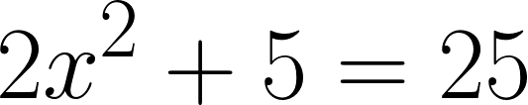
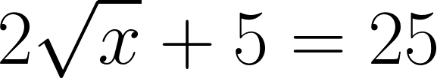
What Linear Algebra Is
If it has an exponential term, it isn’t linear algebra, e.g.:

Slide 16
What Linear Algebra Is
“Solving for unknowns within system of linear equations”
Consider the following example:
Sheriff has 180 km/h car
Bank robber has 150 km/h car and five-minute head start
How long does it take the sheriff to catch the robber?
What distance will they have traveled at that point?
(For simplicity, let’s ignore acceleration, traffic, etc.)

Slide 17
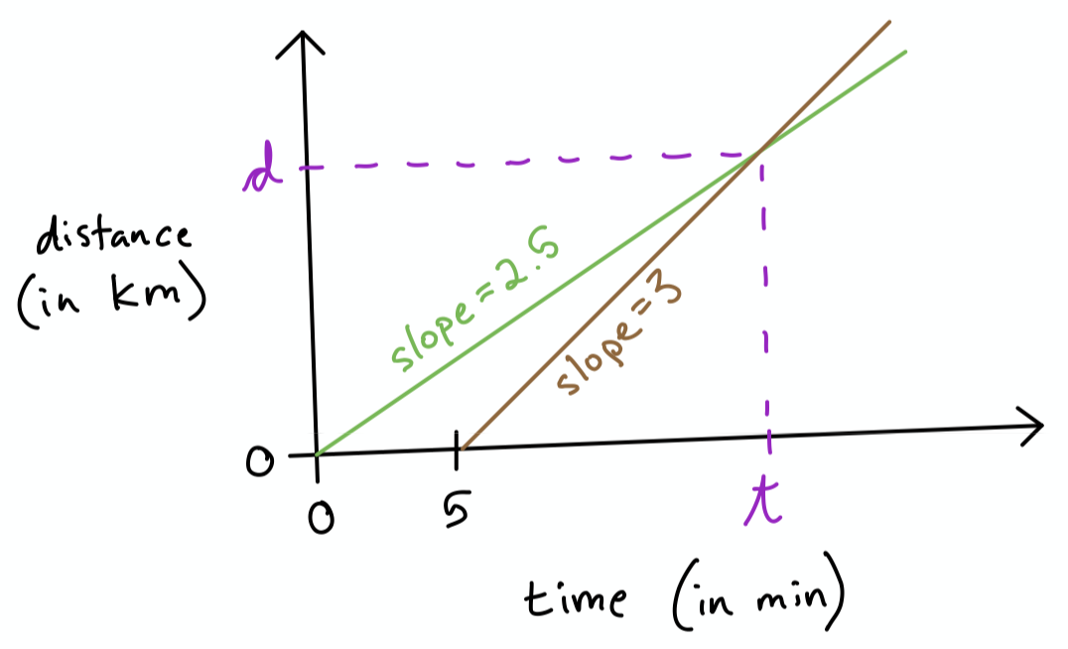
What Linear Algebra Is
Problem could be solved graphically with a plot:
Note that: 150 km/h = 2.5 km/min 180 km/h = 3 km/min

Slide 18
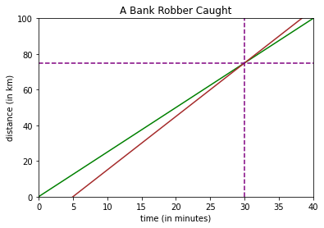
Hands-on code demo: 1-intro-to-linear-algebra.ipynb

Slide 19
What Linear Algebra Is
Alternatively, problem can be solved algebraically:
Equation 1: d = 2.5t
Equation 2: d = 3(t - 5)
2.5t = 3(t - 5)
2.5t = 3t - 15
2.5t - 3t = -15
-0.5t = -15
t = -15/-0.5 = 30 min
d = 2.5t = 2.5(30) = 75 km
d = 3(t - 5) = 3(30 - 5) = 3(25) = 75 km

Slide 20
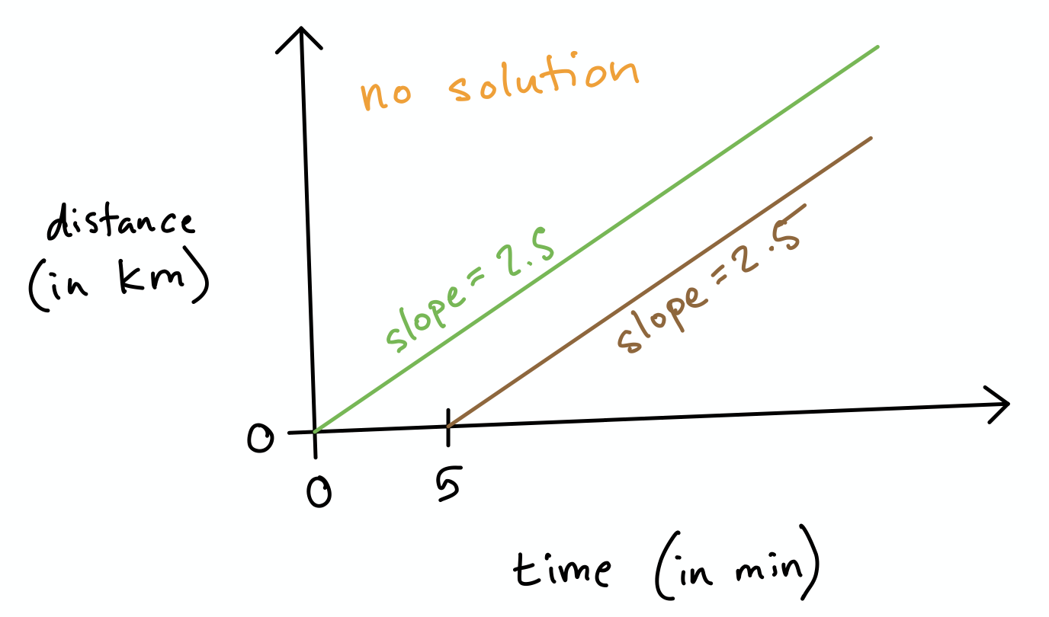
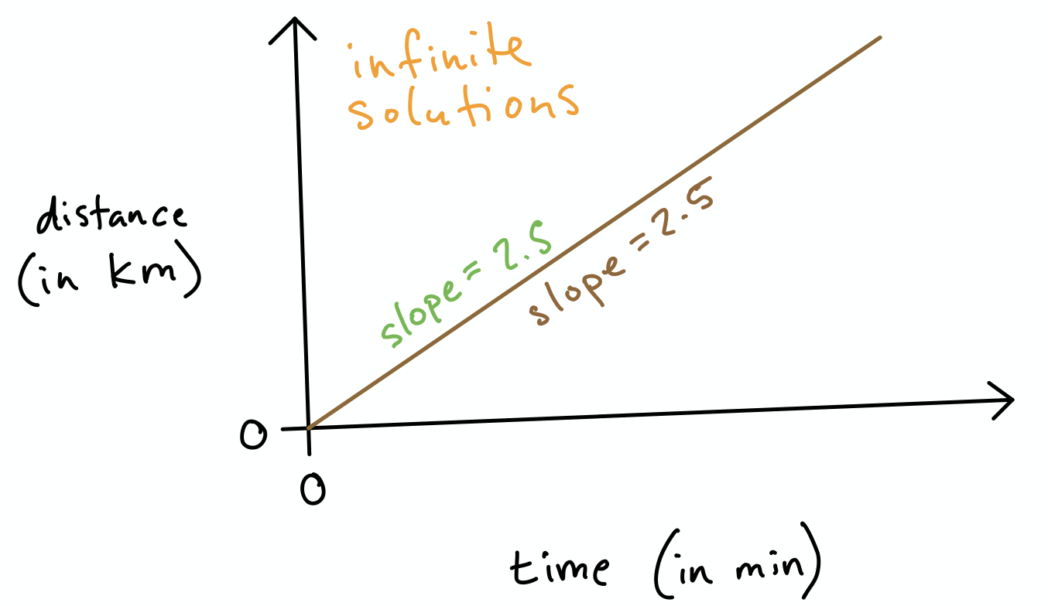
What Linear Algebra Is
No solution if sheriff’s car is same speed as bank robber’s.
Infinite solutions if same speed and same starting time.
These are the only three options in linear algebra: one, no, or infinite solutions.
It is impossible for lines to cross multiple times.

Slide 21
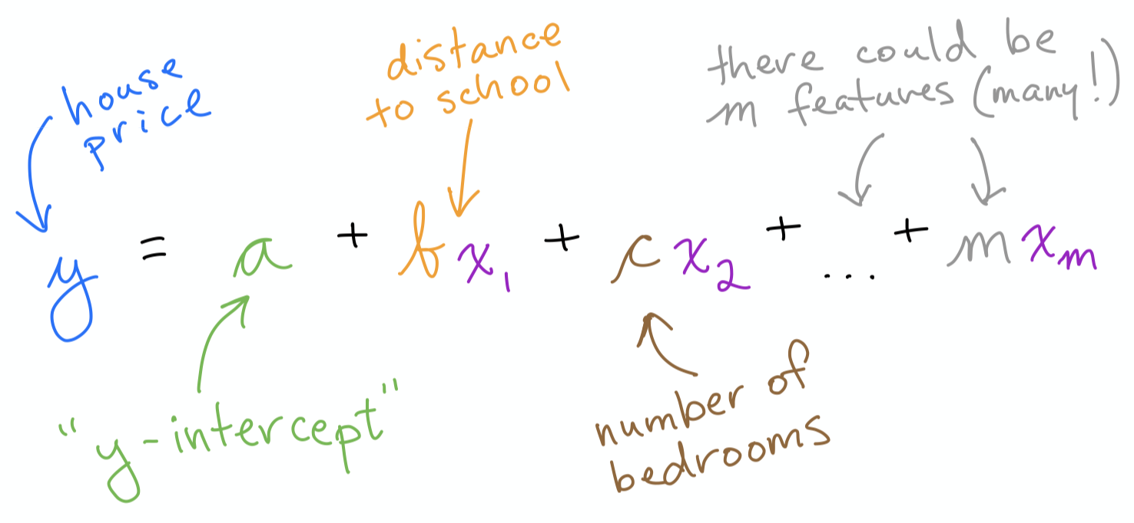
What Linear Algebra Is
In a given system of equations:
Could be many equations
Could be many unknowns in each equation

Slide 22
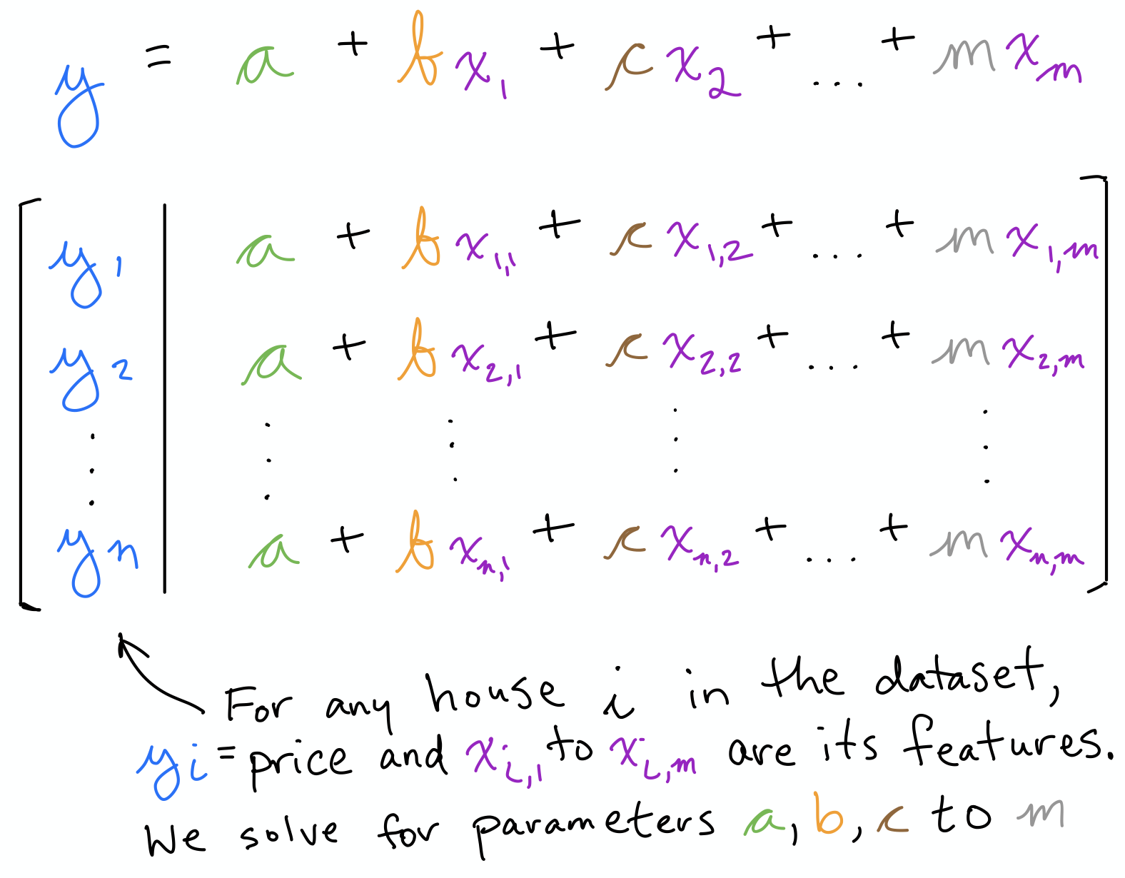

Slide 23
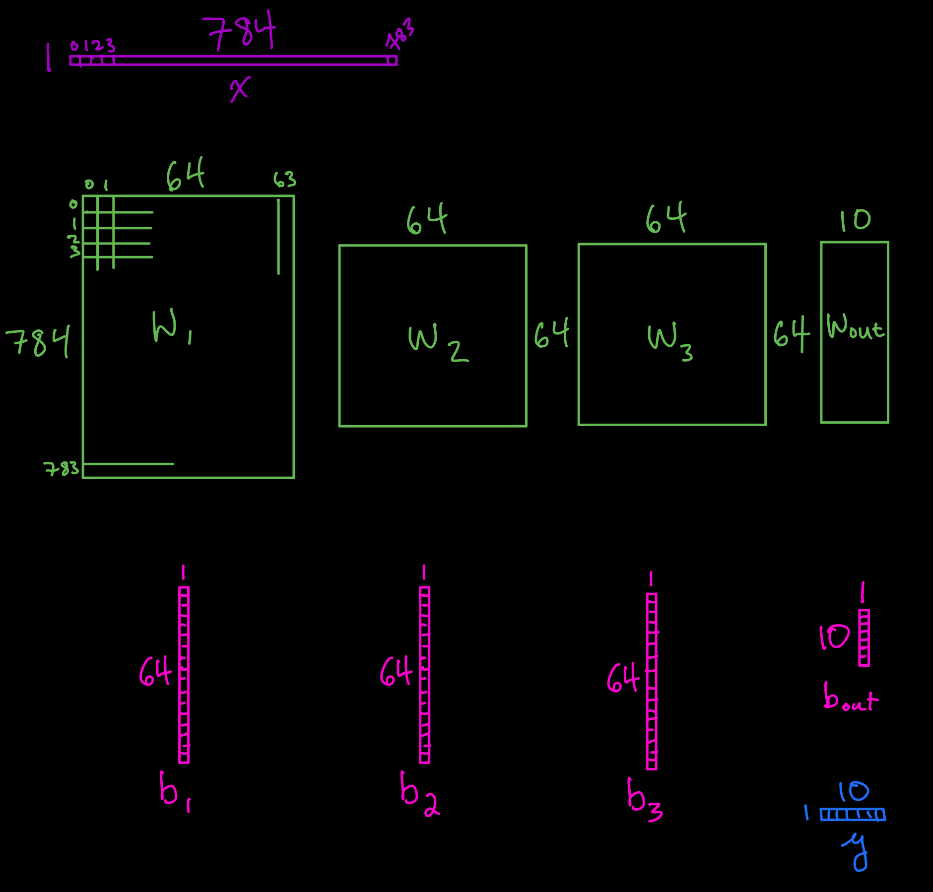
See:
jonkrohn.com/deepTF1
jonkrohn.com/convTF1

Slide 24
A Brief History of Algebra
Al-Khwārizmī'
(c. 780 - c. 850)
wrote The Compendious Book on Calculation by Completion (Arabic: “al-jabr”) and Balancing
By Yunuskhuja Tuygunkhujaev - Own work, CC BY-SA 4.0, https://commons.wikimedia.org/w/index.php?curid=47897611

Slide 25
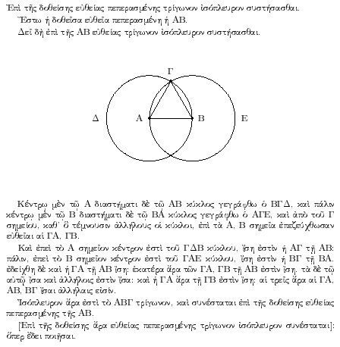
A Brief History of Algebra
1900 BCE: Babylonian “rhetorical”
1650 BCE: Egyptians
6th century BCE: Indians
400-300 BCE: Greeks
250 BCE: Chinese
Europeans much later:
12th century: Arabic to Latin trans.
13th century: rivaled others

Slide 26
A Brief History of Algebra
Contemporary applications:
Solving for unknowns in ML algos, including deep learning
Reducing dimensionality (e.g., principal component analysis)
Ranking results (e.g., with eigenvector)
Recommenders (e.g., singular value decomposition, SVD)
Natural language processing (e.g., SVD, matrix factorization)
Topic modeling
Semantic analysis

Slide 27
Exercise
Jill designs solar panels as a hobby.
On April 1st, Jill’s “Mark I” design begins generating power: 1 kJ/day.
On May 1st, her “Mark II” design begins generating 4 kJ of power per day.
What day is it when Jill’s Mark II design has generated as much total energy as the Mark I design?
How much total energy have both generated by that day?
What would the solutions to (1.) and (2). be if Mark II design generated 1kJ of power per day?

Slide 28
Solutions
40 days from April 1st, which is May 10th
40 kJ generated by each design for a total of 80 kJ
No solutions.

Slide 29
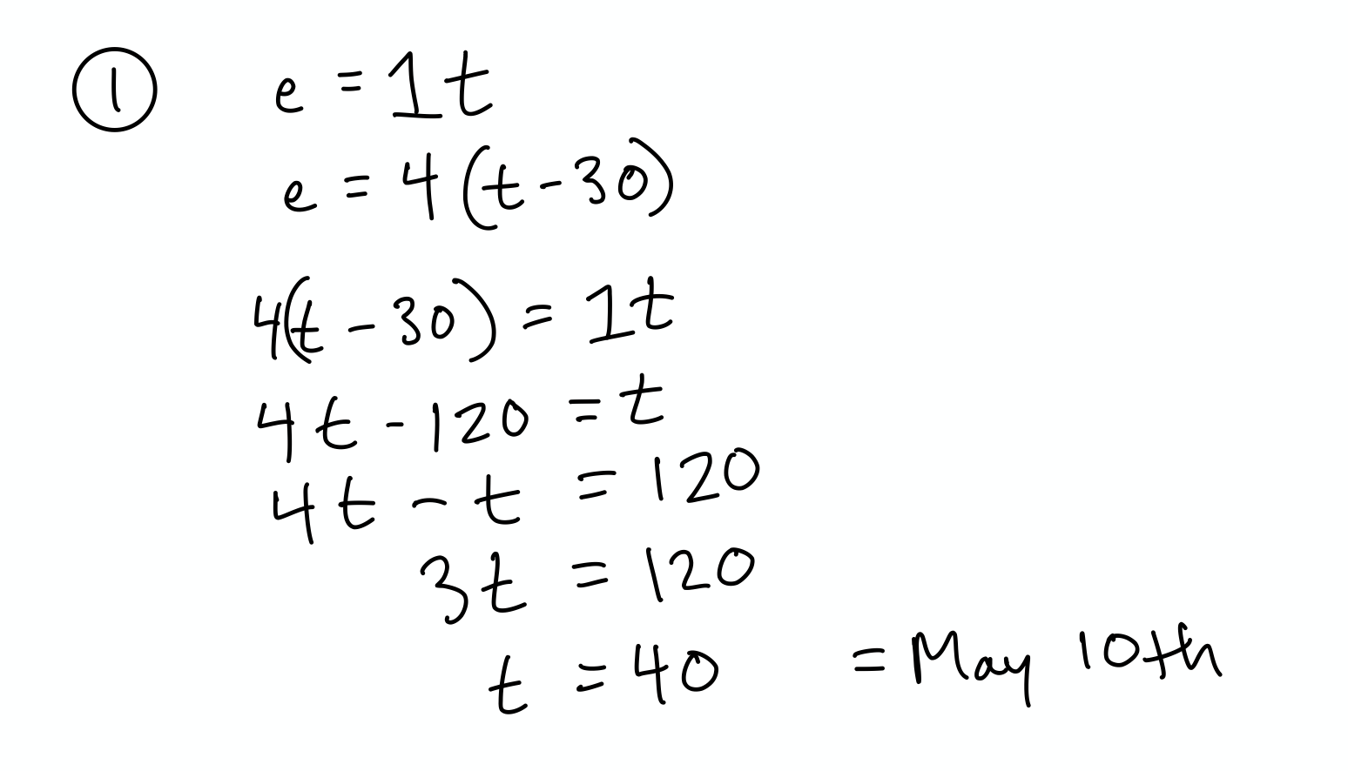

Slide 30
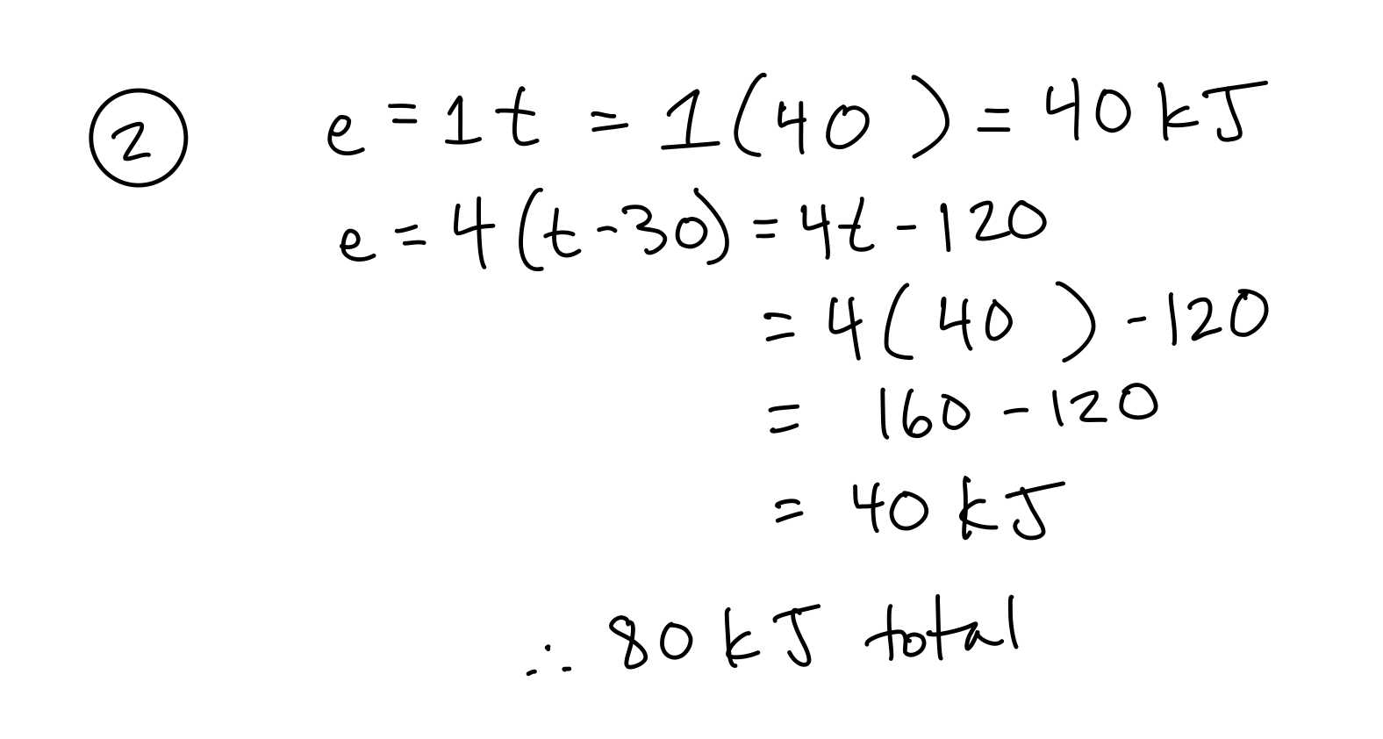

Slide 31
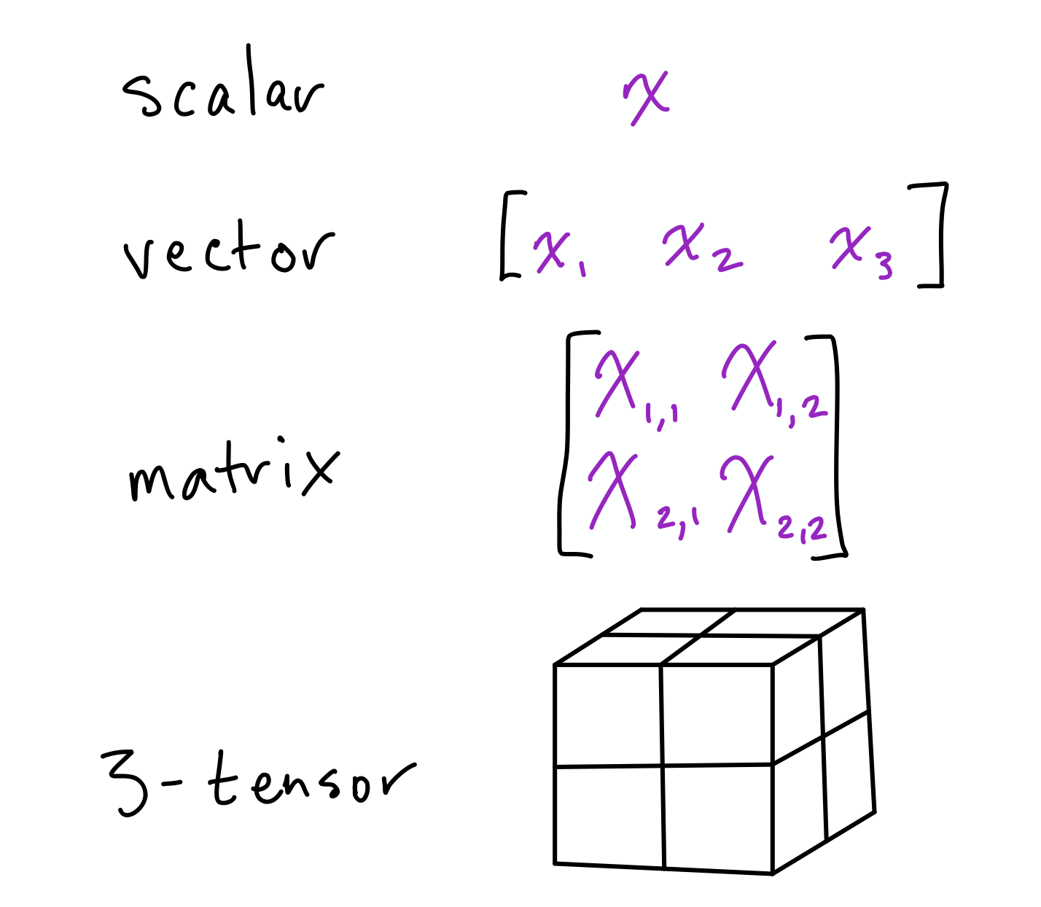
Tensors
“ML generalization of vectors and matrices to any number of dimensions”
Dimensions | Mathematical Name | Description
0 | scalar | magnitude only
1 | vector | array
2 | matrix | flat table, e.g., square
3 | 3-tensor | 3D table, e.g., cube
n | n-tensor | higher dimensional

Slide 32
Scalars
No dimensions
Single number
Denoted in lowercase, italics, e.g.: x
Should be typed, like all other tensors: e.g., int, float32
Hands-on code demo: 1-intro-to-linear-algebra.ipynb

Slide 33
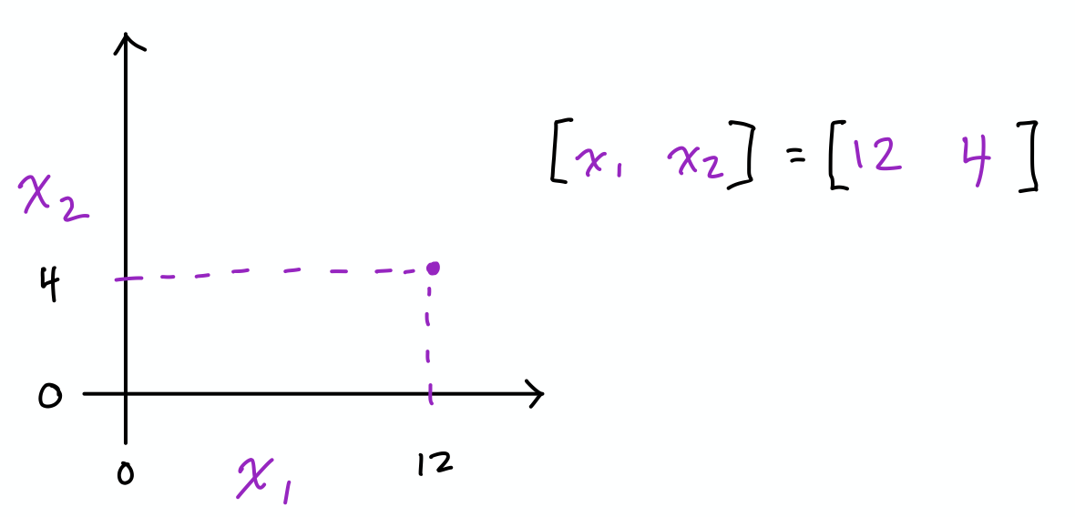
Vectors
One-dimensional array of numbers
Denoted in lowercase, italics, bold, e.g.: x
Arranged in an order, so element can be accessed by its index
Elements are scalars so not bold, e.g., second element of x is x₂
Representing a point in space:
Vector of length two represents location in 2D matrix (shown)
Length of three represents location in 3D cube
Length of n represents location in n-dimensional space

Slide 34
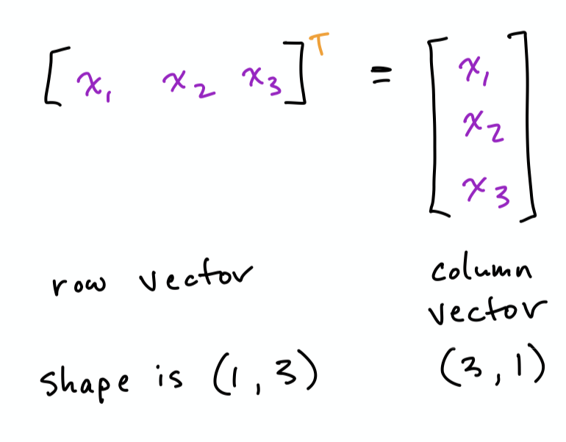
Vector Transposition
Hands-on code demo

Slide 35
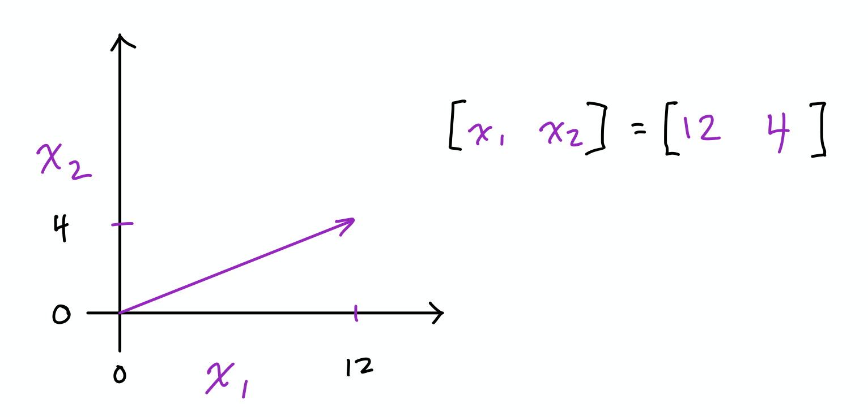
Norms
Vectors represent a magnitude and direction from origin:
Norms are functions that quantify vector magnitude.

Slide 36
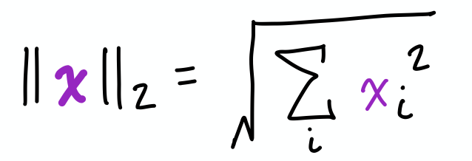
L² Norm
Described by:
Measures simple (Euclidean) distance from origin
Most common norm in machine learning
Instead of ||x||₂, it can be denoted as ||x||
Hands-on code demo

Slide 37
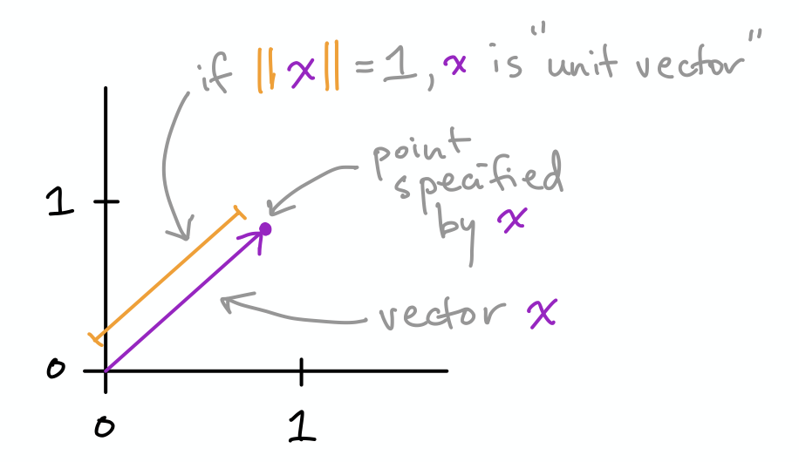
Unit Vectors
Special case of vector where its length is equal to one
Technically, x is a unit vector with “unit norm”, i.e.: ||x|| = 1

Slide 38
Beyond the L² Norm
Over next few slides, we’ll skim over other common norms in ML
For our immediate purposes, only L² is important

Slide 39
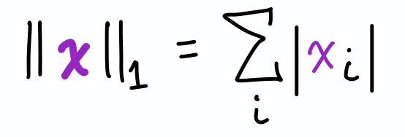
L¹ Norm
Described by:
Another common norm in ML
Varies linearly at all locations whether near or far from origin
Used whenever difference between zero and non-zero is key
Hands-on code demo

Slide 40
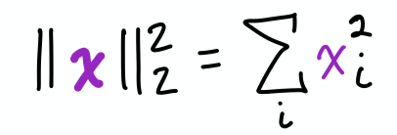
Squared L² Norm
Described by:
Computationally cheaper to use than L² norm because:
Squared L² norm equals simply x^{T}x
Derivative (used to train many ML algorithms) of element x requires that element alone, whereas L² norm requires x vector
Downside is it grows slowly near origin so can’t be used if distinguishing between zero and near-zero is important
Hands-on code demo

Slide 41
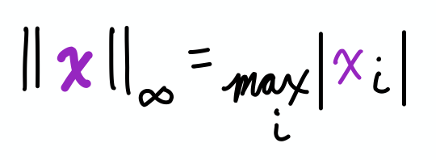
Max Norm (or L∞ Norm)
Described by:
Final norm we’ll discuss; also occurs frequently in ML
Returns the absolute value of the largest-magnitude element
Hands-on code demo

Slide 42
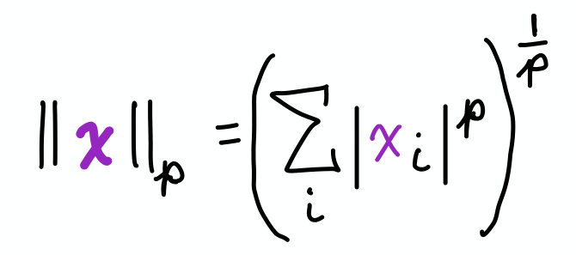
Generalized L^{p} Norm
Described by:
p must be:
A real number
Greater than or equal to one
Can derive L¹, L², and L∞ norm formulae by substituting for p
Norms, particularly L¹ and L², used to regularize objective functions

Slide 43
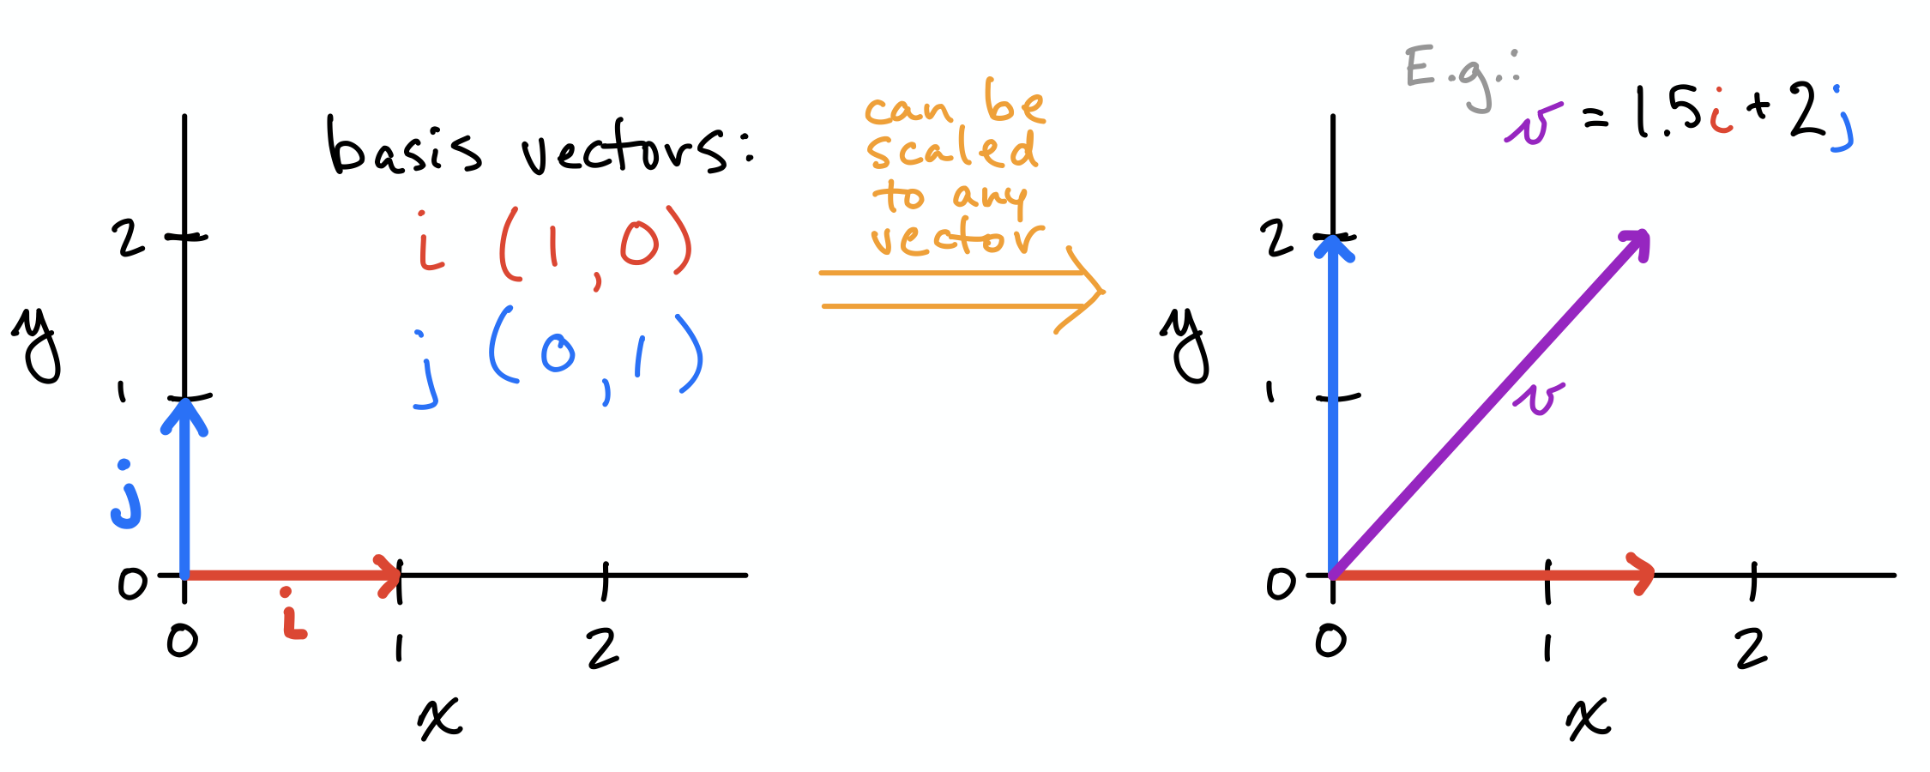
Basis Vectors
Can be scaled to represent any vector in a given vector space
Typically use unit vectors along axes of vector space (shown)

Slide 44
Orthogonal Vectors
x and y are orthogonal vectors if x^{T}y = 0
Are at 90º angle to each other (assuming non-zero norms)
n-dimensional space has max n mutually orthogonal vectors (again, assuming non-zero norms)
Orthonormal vectors are orthogonal and all have unit norm
Basis vectors are an example
Hands-on code demo

Slide 45
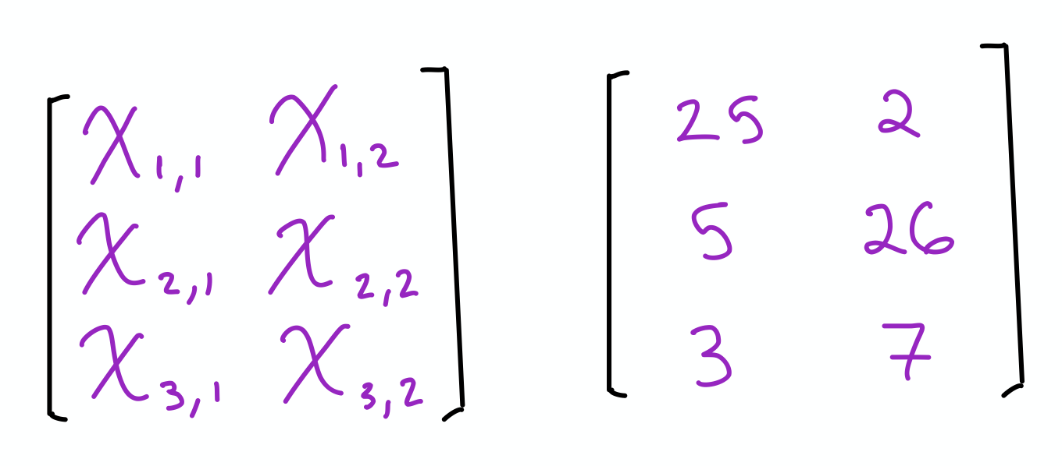
Matrices
Two-dimensional array of numbers
Denoted in uppercase, italics, bold, e.g.: X
Height given priority ahead of width in notation, i.e.: (n_{row}, n_{col})
If X has three rows and two columns, its shape is (3, 2)
Individual scalar elements denoted in uppercase, italics only
Element in top-right corner of matrix X above would be X_{1,2}
Colon represents an entire row or column:
Left column of matrix X is X_{:,1}
Middle row of matrix X is X_{2,:}
Hands-on code demo

Slide 46
Generic Tensor Notation
Upper-case, bold, italics, sans serif, e.g., X
In a 4-tensor X, element at position (i, j, k, l) denoted as X_{(i, j, k, l)}
Hands-on code demo of Higher-Rank Tensors

Slide 47
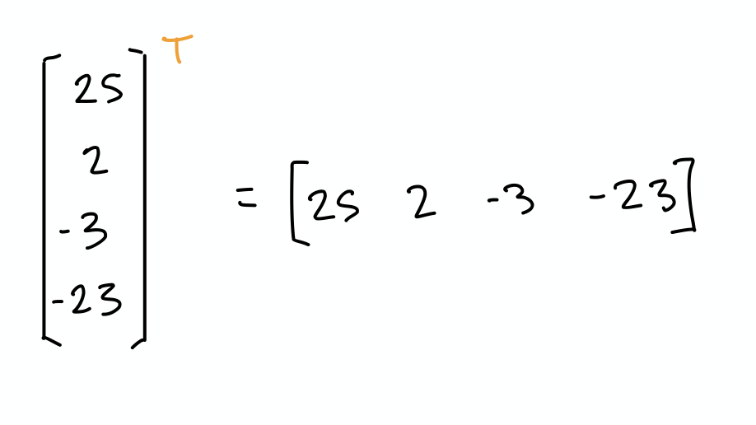
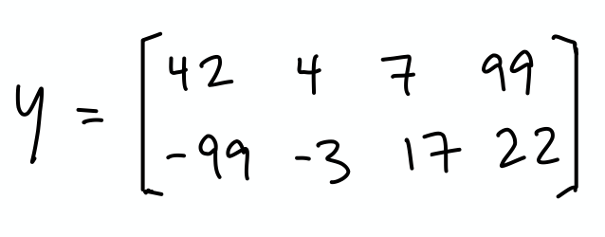
Exercises
What is the transpose of this vector?
Using algebraic notation, what are the dimensions of this matrix Y?
Using algebraic notation, what is the position of the element in this matrix Y with the value of 17?

Slide 48
Solutions
1.
2. (2, 4)
3. Y_{2,3}

Slide 49
Intro to Linear Algebra
Data Structures for Algebra
Common Tensor Operations
Matrix Properties

Slide 50
Segment 2: Tensor Operations
Tensor Transposition
Basic Tensor Arithmetic
Reduction
The Dot Product
Solving Linear Systems

Slide 51
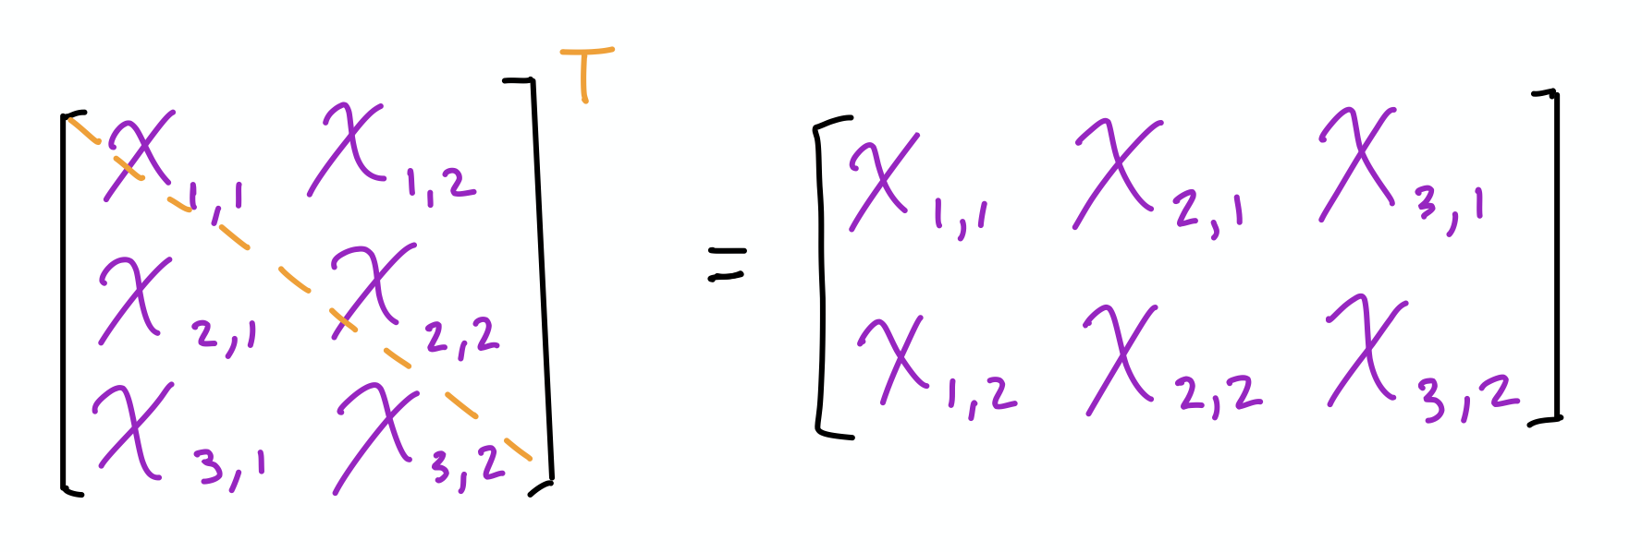
Tensor Transposition
Transpose of scalar is itself, e.g.: x^{T} = x
Transpose of vector, seen earlier, converts column to row (and vice versa)
Scalar and vector transposition are special cases of matrix transposition:
Flip of axes over main diagonal such that:
(X^{T})_{i,j} = X_{j,i}
Hands-on code demo

Slide 52
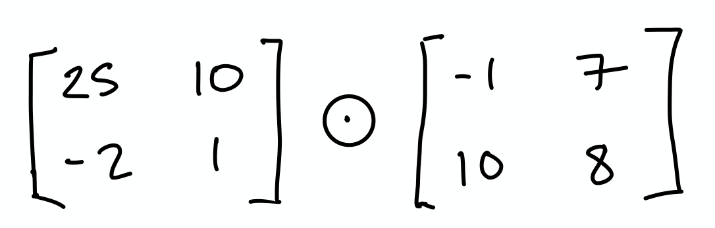
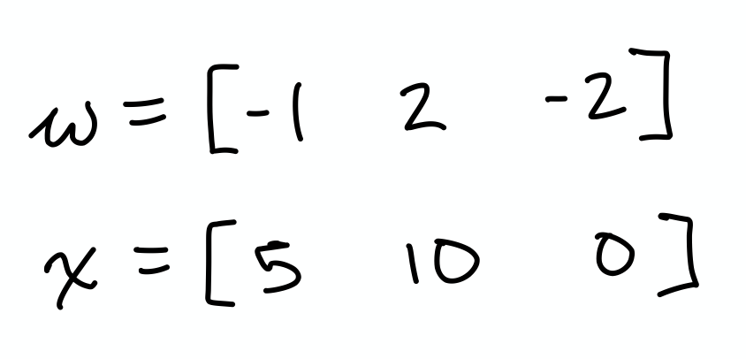
Exercises
What is Y^{T}?
What is the Hadamard product of these matrices?
What is the dot product of the tensors w and x?

Slide 53
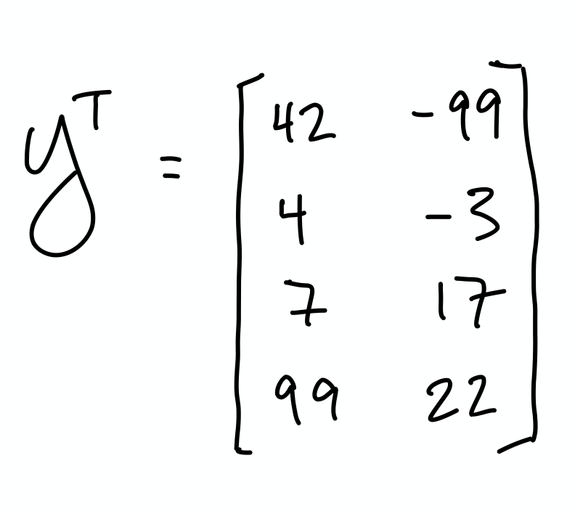
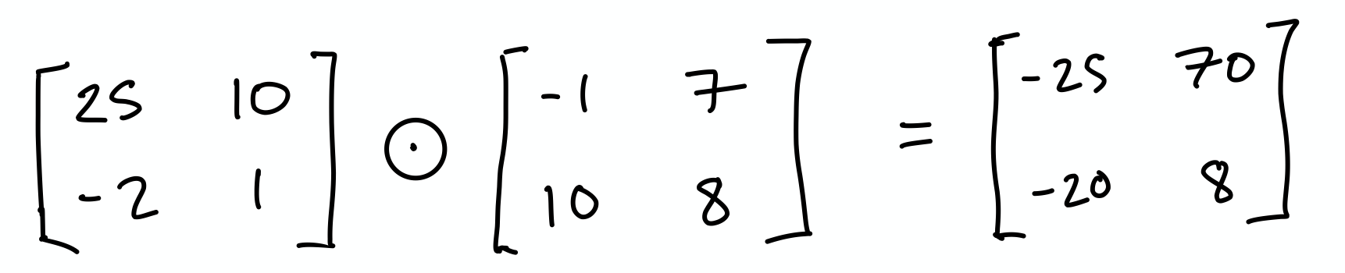
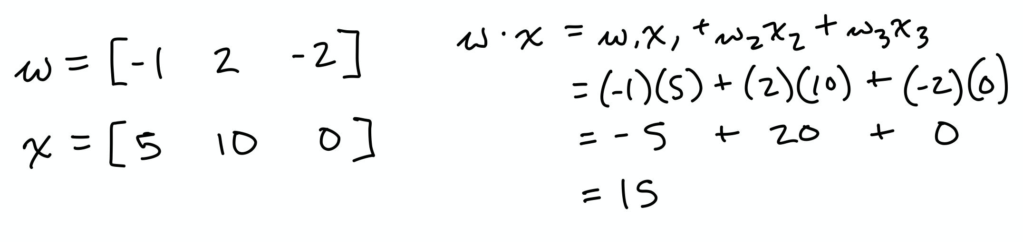
Solutions

Slide 54
Answers
1.
2.
3. 15

Slide 55
Solving Linear Systems
In the next segment, we’ll cover enough theory to use matrices to solve some simple linear systems computationally.
To understand the problem of solving linear systems more intimately, let’s first solve some algebraically on paper.

Slide 56
Solving Linear Systems
Method 1: Substitution
Use whenever there’s a variable in system with coefficient of 1
For example, when solving for x and y in the following system:
y = 3x
-5x + 2y = 2
...we can substitute y with 3x in the second equation.

Slide 57
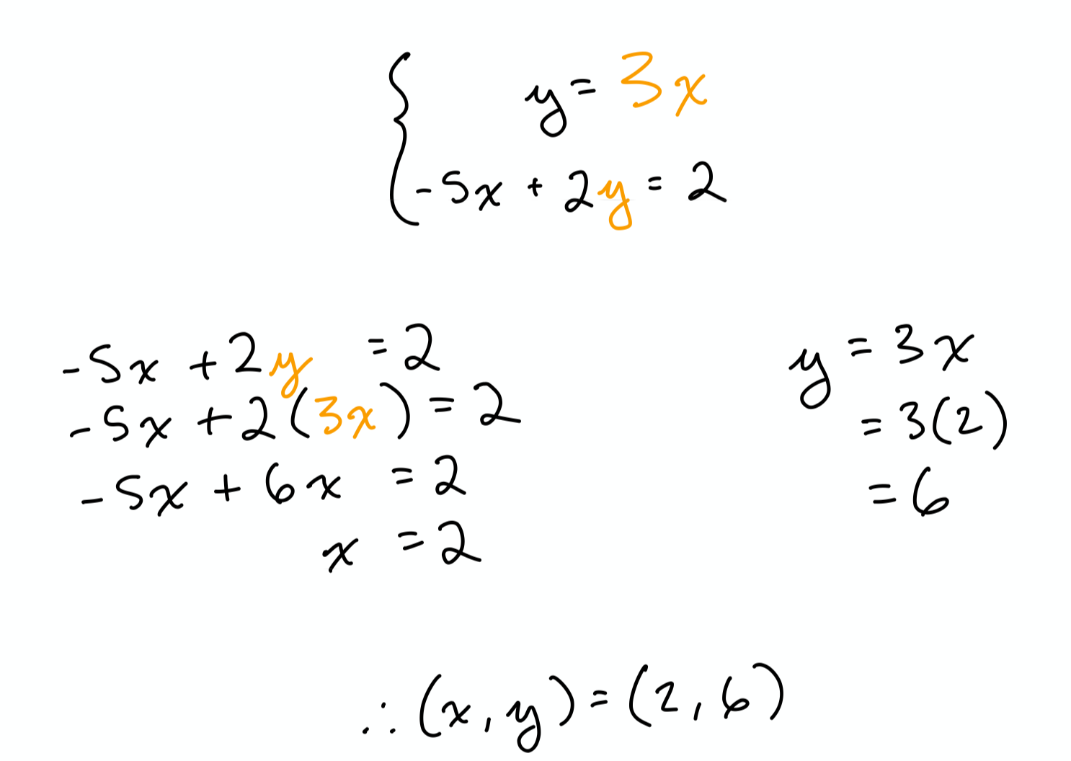
Substitution
Hands-on code demo

Slide 58
Exercises
Solve for the unknowns in the following systems of equations:
x + y = 6 and 2x + 3y = 16
2. -x + 4y = 0 and 2x - 5y = -6
3. y = 4x + 1 and -4x + y = 2

Slide 59
Solutions
(2, 4)
(-8, -2)
No solution.

Slide 60
Solving Linear Systems
Method 2: Elimination
Typically best option if no variable in system has coefficient of 1
Use addition property of equations to eliminate variables
If necessary, multiply one or both equations to make elimination of a variable possible
For example, solve for the unknowns in the following system:
2x - 3y = 15
4x + 10y = 14
...by multiplying the first equation by -2 and adding the equations.

Slide 61
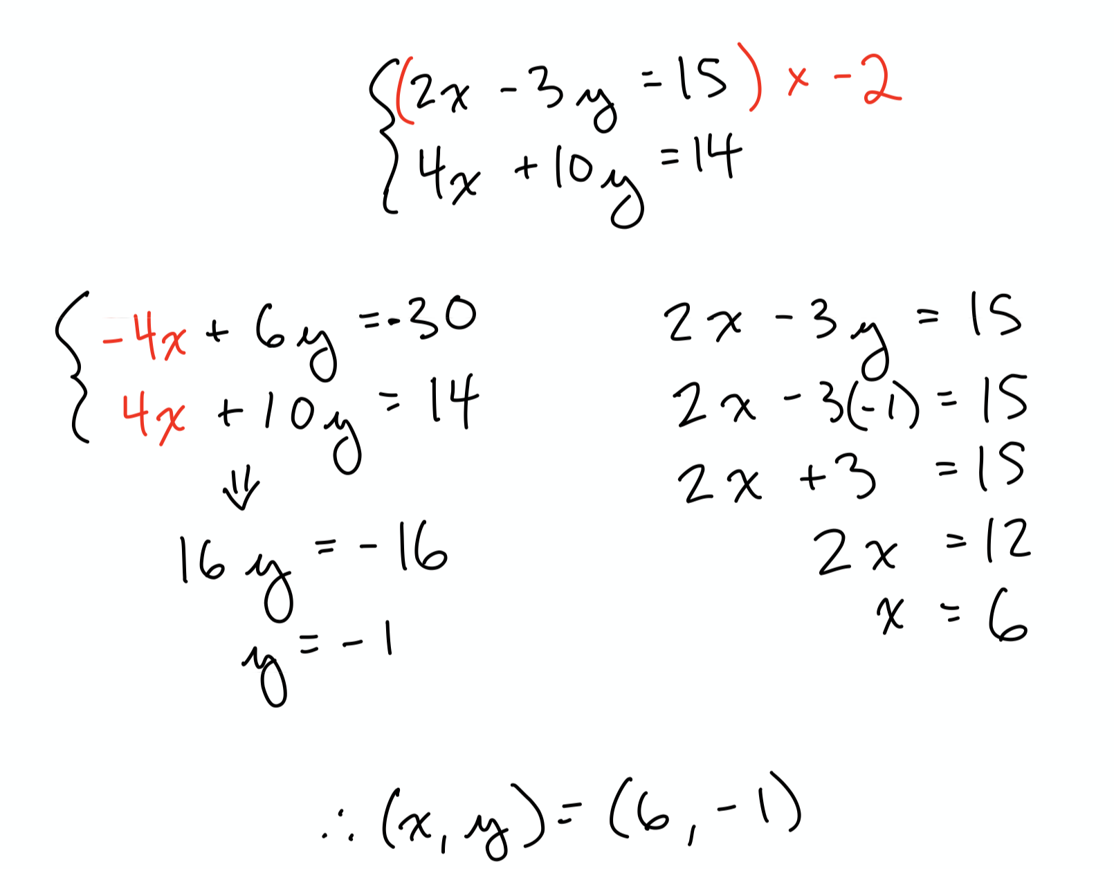
Elimination
Hands-on code demo

Slide 62
Exercises
Solve for the unknowns in the following systems of equations:
4x - 3y = 25 and -3x + 8y = 10
2. -9x - 15y = -15 and 3x + 5y = -10
3. 4x + 2y = 4 and -5x - 3y = -7

Slide 63
Solutions
(10, 5)
No solution.
(-1, 4)

Slide 64
Intro to Linear Algebra
Data Structures for Algebra
Common Tensor Operations
Matrix Properties

Slide 65
Segment 3: Matrix Properties
The Frobenius Norm
Matrix Multiplication
Symmetric and Identity Matrices
Matrix Inversion
Diagonal Matrices
Orthogonal Matrices

Slide 66
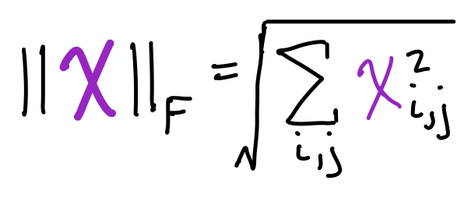
Frobenius Norm
Described by:
Analogous to L² norm of vector
Measures the size of matrix in terms of Euclidean distance
It’s the sum of the magnitude of all the vectors in X
Hands-on code demo

Slide 67
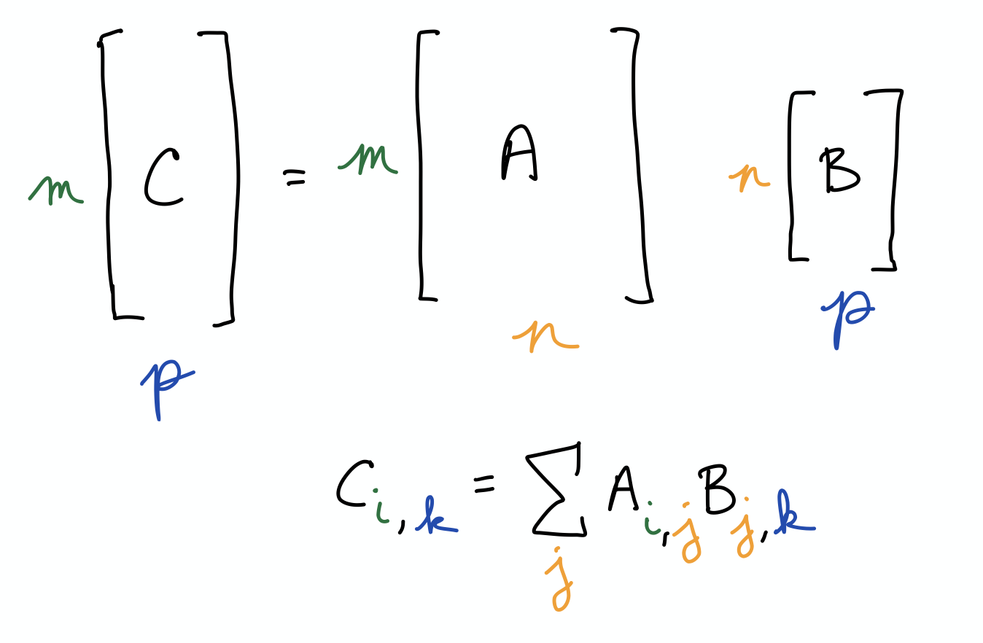
Matrix Multiplication

Slide 68
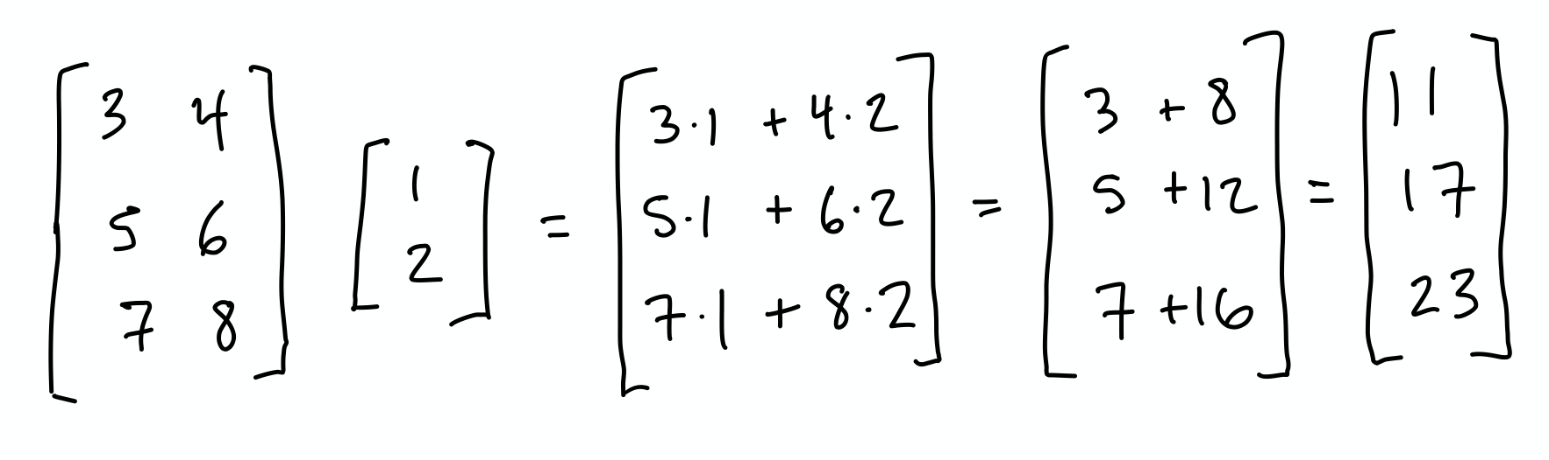
Matrix Multiplication (with a Vector)
Hands-on code demo

Slide 69
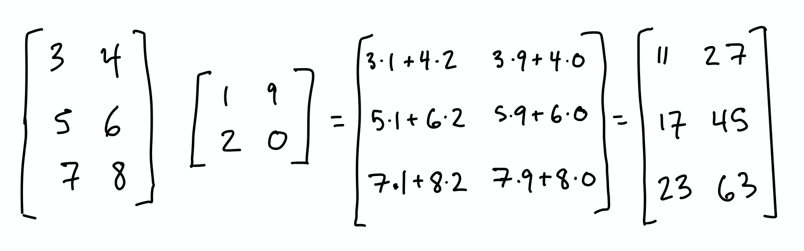
(Matrix-by-)Matrix Multiplication
Hands-on code demo

Slide 70
Strictly speaking, x extends rightward to m-1 not m because of the presence of a on the far left.

Slide 71
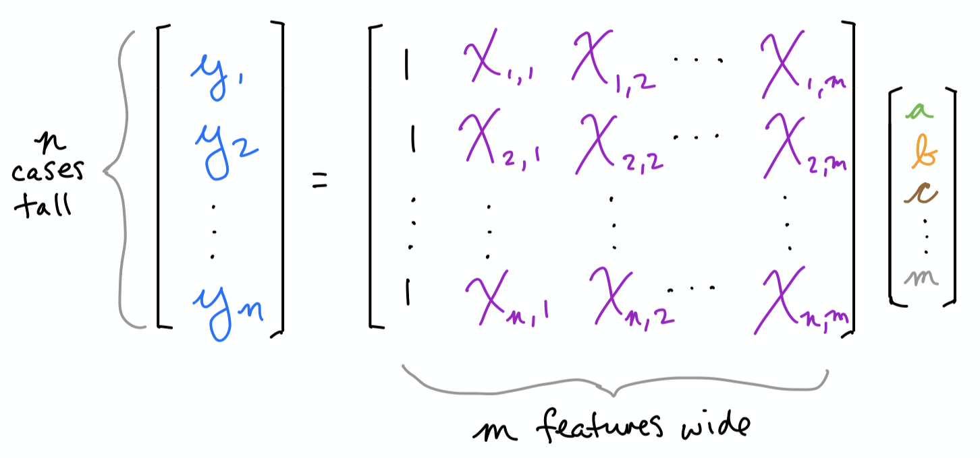
Matrix Multiplication (in Regression)
In other words, the matrix represents an m-dimensional space.

Slide 72
Matrix Multiplication (in Deep Learning)
See:
artificial-neurons.ipynb
jonkrohn.com/deepTF1
jonkrohn.com/convTF1
jonkrohn.com/convTF2
jonkrohn.com/deepPT

Slide 73
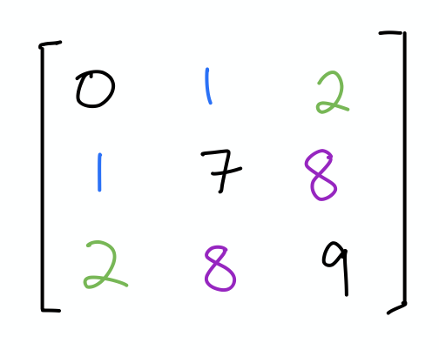
Symmetric Matrices
Special matrix case with following properties:
Square
X^{T} = X
Hands-on code demo

Slide 74
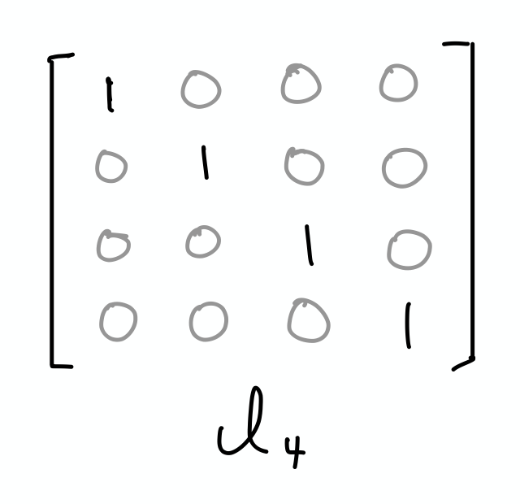
Identity Matrices
Symmetric matrix where:
Every element along main diagonal is 1
All other elements are 0
Notation: I_{n} where n = height (or width)
n-length vector unchanged if multiplied by I_{n}
Hands-on code demo

Slide 75
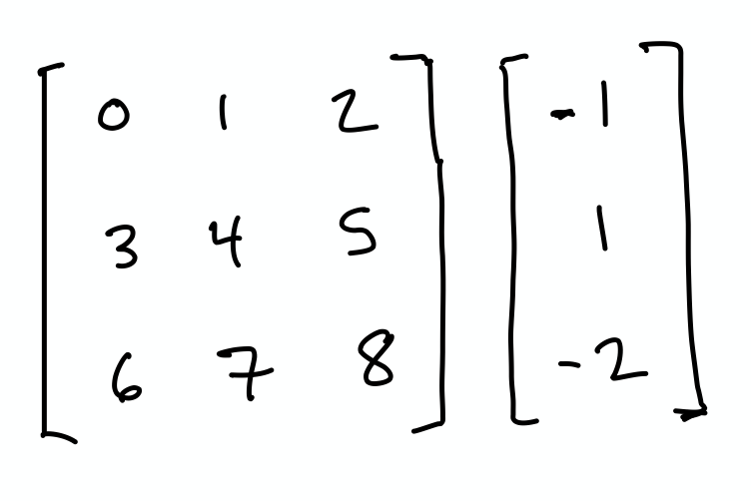
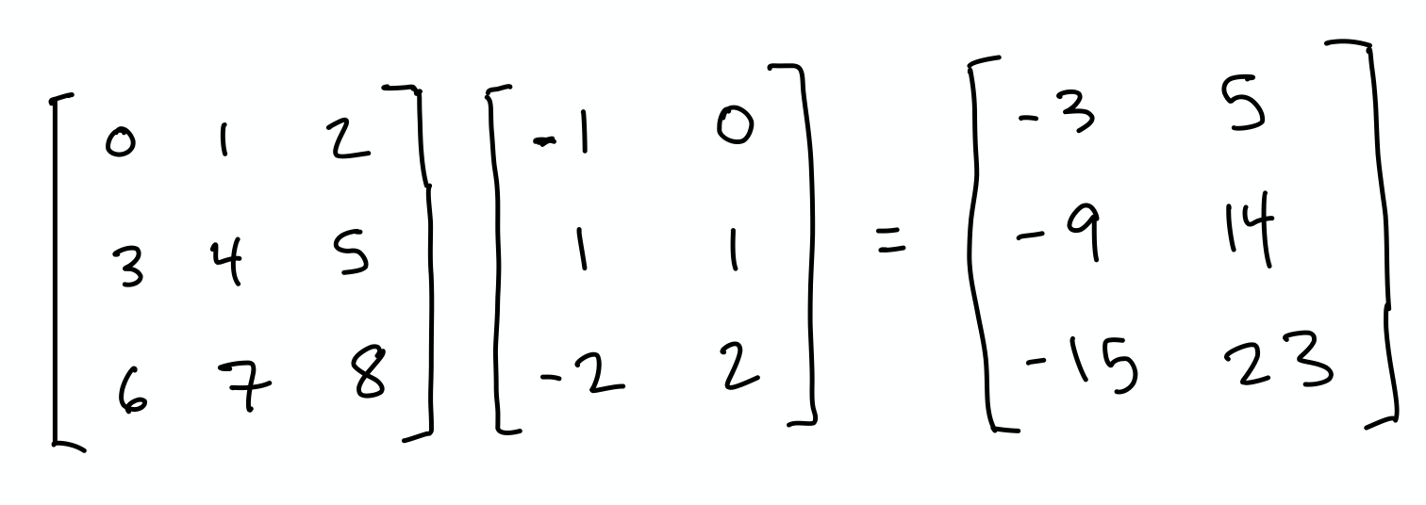
Exercises
Using paper and pen(cil), multiply the following tensors:
1.
2. Repeat Q1 using the same vector but replace matrix with I₃
3.

Slide 76
Solutions
[-3, -9, -15]
[-1, 1, -2]

Slide 77
Matrix Inversion
Clever, convenient approach for solving linear equations
An alternative to manually solving with substitution or elimination
Matrix inverse of X is denoted as X ⁻¹
Satisfies: X ⁻¹X = I_{n}

Slide 78
Matrix Inversion
The regression formula can be represented as:
y = Xw (w is the vector of weights a through m)

Slide 79
Matrix Inversion
In the equation y = Xw:
We know the outcomes y, which could be house prices
We know the features X, which are predictors like bedroom count
Vector w contains the unknowns, the model’s learnable parameters
Assuming X ⁻¹ exists, matrix inversion can solve for w:
Xw = y
X ⁻¹Xw = X ⁻¹y
I_{n}w = X ⁻¹y
w = X ⁻¹y

Slide 80
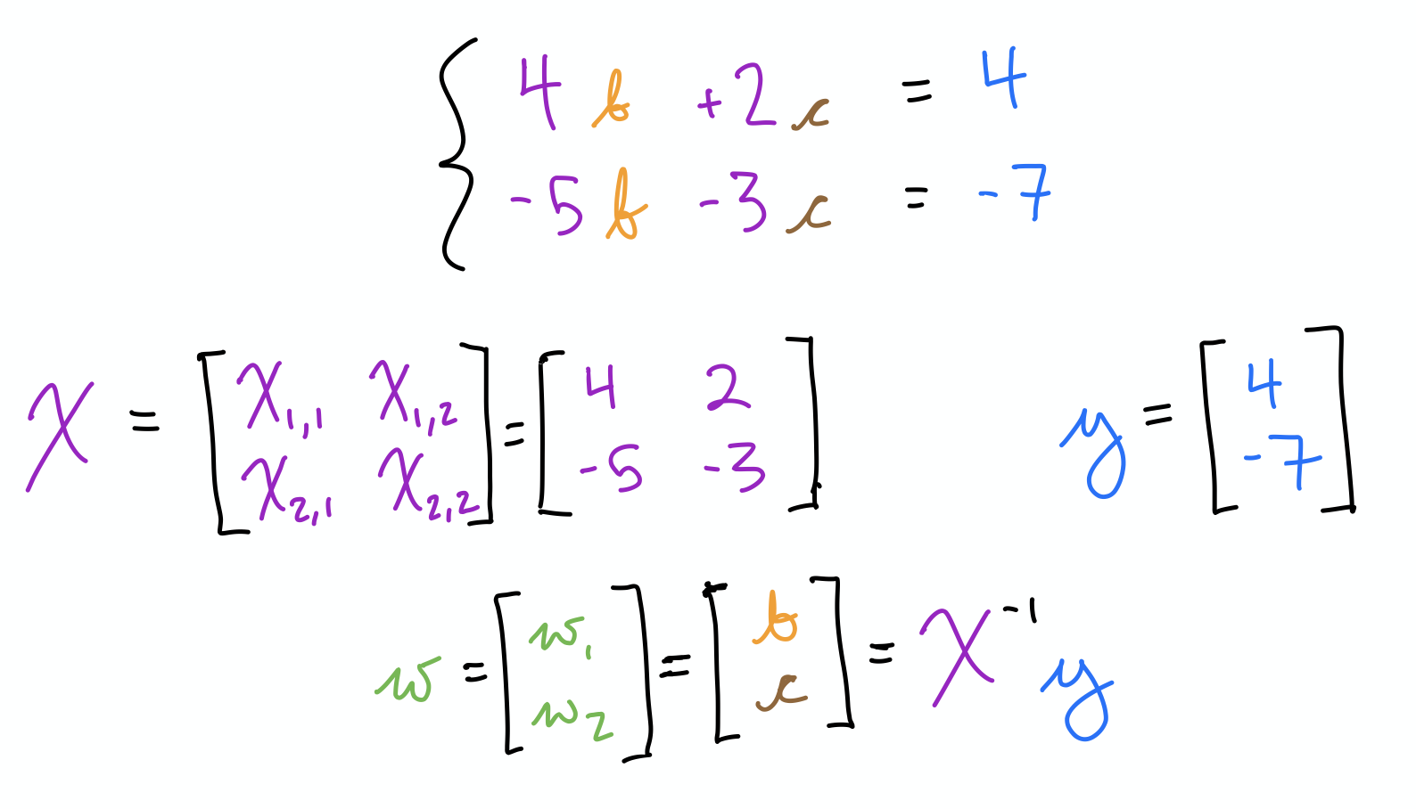
Matrix Inversion
Hands-on code demo

Slide 81
Matrix Inversion
Nifty trick, but can only be calculated if:
Matrix isn’t “singular”
That is, all columns of matrix must be linearly independent
E.g., if a column is [1, 2], another can’t be [2, 4] or also be [1, 2]

Slide 82
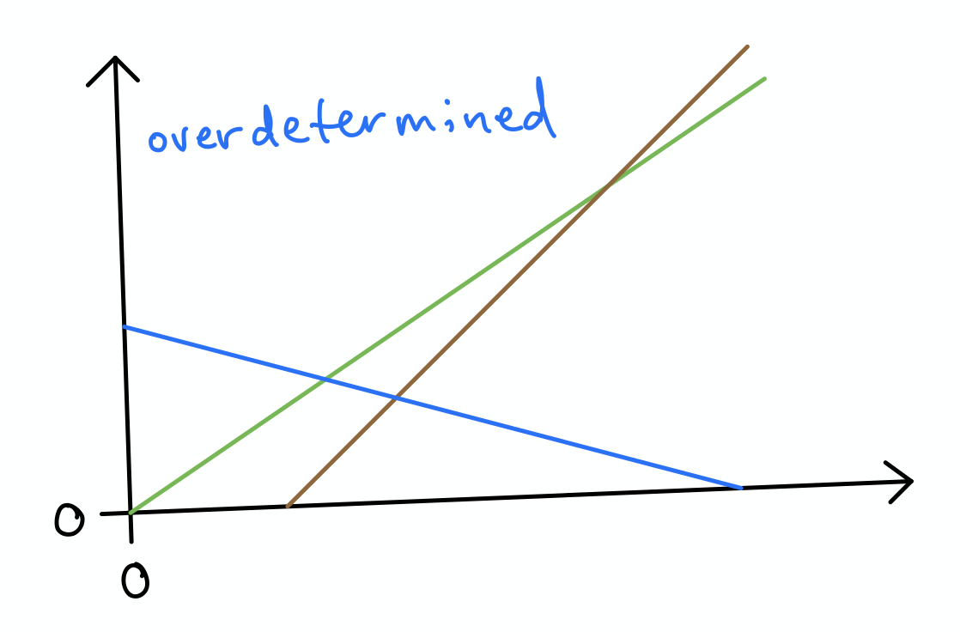
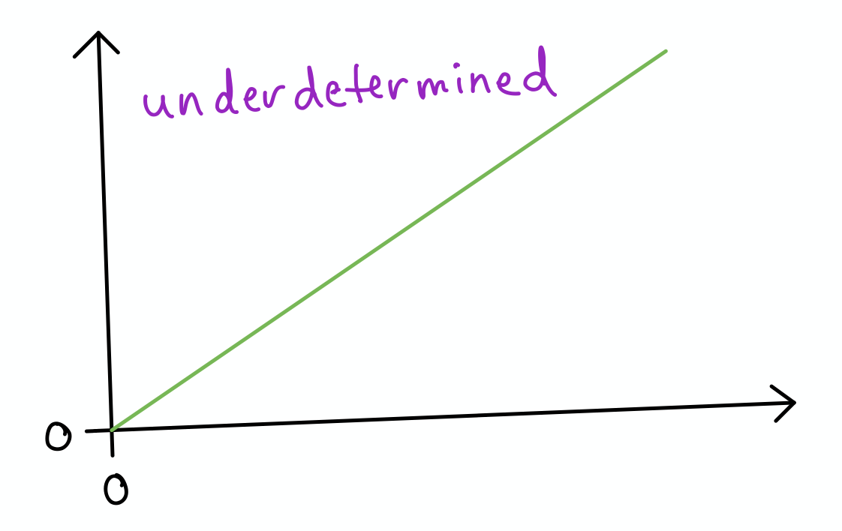
Matrix Inversion
...Can also only be calculated if:
Matrix is square: n_{row} = n_{col} (i.e., “vector span” = “matrix range”)
Avoids overdetermination: n_{row} > n_{col} -- i.e.: n_{equations} > n_{dimensions}
Avoids underdetermination: n_{row} < n_{col} -- i.e.: n_{equations} < n_{dimensions}
Note that solving for unknowns may still be possible by other means if matrix can’t be inverted (Algebra II)
Hands-on code demo

Slide 83
Diagonal Matrices
Nonzero elements along main diagonal; zeros everywhere else
Identity matrix is an example
If square, denoted as diag(x) where x is vector of main-diagonal elements
Computationally efficient:
Multiplication: diag(x)y = x ⊙ y
Inversion: diag(x)⁻¹ = diag[1/x₁, … , 1/x_{n}]^{T}
Can’t divide by zero so x can’t include zero
Can be non-square and computation still efficient:
If h > w, simply add zeros to product
If w > h, remove elements from product

Slide 84
Orthogonal Matrices
Recall orthonormal vectors from earlier:
In orthogonal matrices, orthonormal vectors:
Make up all rows
Make up all columns
This means: A^{T}A = AA^{T} = I
Which also means: A^{T} = A⁻¹I = A⁻¹
Calculating A^{T} is cheap, therefore so is calculating A⁻¹
Note that “orthonormal matrix” isn’t a thing.
And there’s no name for a matrix made of orthogonal vectors.

Slide 85
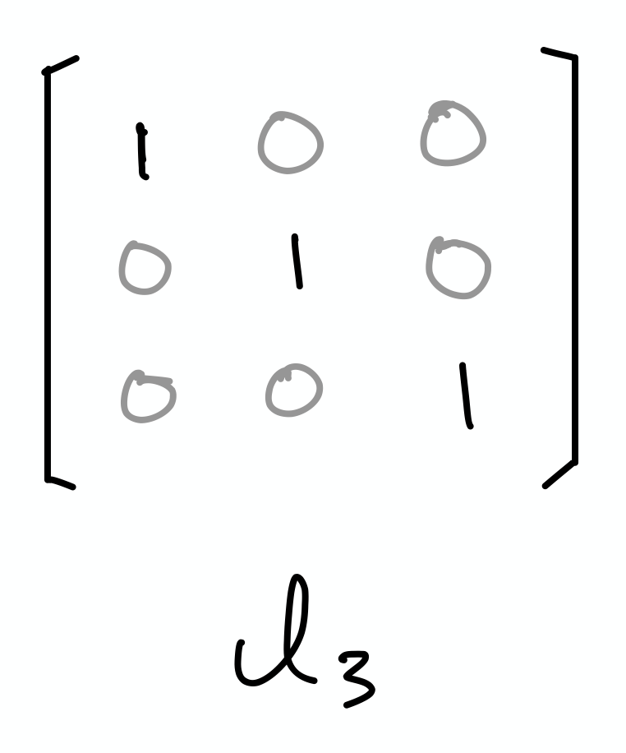
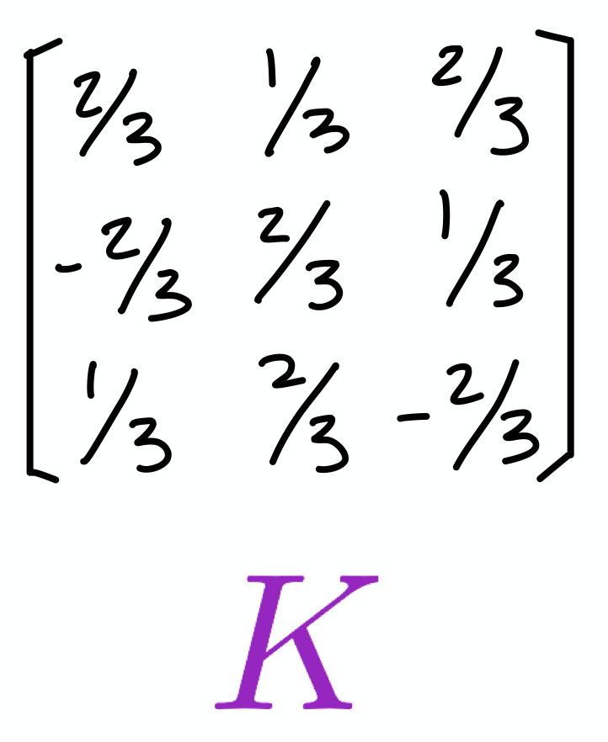
Exercises
Identity matrices are orthogonal.
With paper and pencil, use the dot product to demonstrate that any two columns of I₃ are orthogonal to each other.
Similarly, use paper and pencil to demonstrate that each of the columns of I₃ has unit norm.
Repeat Exercises (1.) and (2.) using code, e.g., NumPy.
Now using matrix K instead of I₃, repeat Exercises (1.) through (3.) to assess whether K is orthogonal.

Slide 86
POLL with Multiple Answers Possible
What follow-up topics interest you most?
More Linear Algebra
Calculus
Probability / Statistics
Computer Science (e.g., algorithms, data structures)
Machine Learning Basics
Advanced Machine Learning, incl. Deep Learning
Something Else

Slide 87

Stay in Touch
jonkrohn.com to sign up for email newsletter
linkedin.com/in/jonkrohn
youtube.com/c/JonKrohnLearns
twitter.com/JonKrohnLearns

Slide 88


Slide 89
PLACEHOLDER FOR:
5-Minute Timer

Slide 90
PLACEHOLDER FOR:
10-Minute Timer

Slide 91
PLACEHOLDER FOR:
15-Minute Timer

